Slide 1


TRAFFIC LIGHT CONTROLLER
TEAM MEMBERS
Sandhya A
Roopa Thangam R
Hariharan M

Slide 2
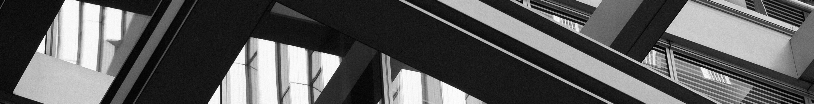
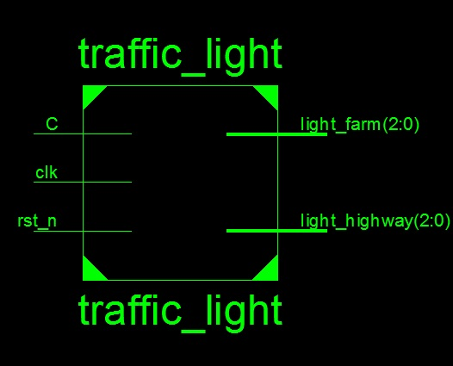
OVERVIEW
A traffic light controller is a digital system used to manage the flow of traffic at intersections by controlling the traffic lights.
It typically consists of a set of rules that dictate when each light (red, yellow, and green) should be illuminated based on the current state of the intersection.

Slide 3
WHAT DOES A TRAFFIC LIGHT CONTROLLER DO?
A traffic light controller manages the sequence of traffic lights to ensure the safe and efficient movement of vehicles and pedestrians through an intersection.
It defines the timing and logic for switching lights from red to green and vice versa.

Slide 4
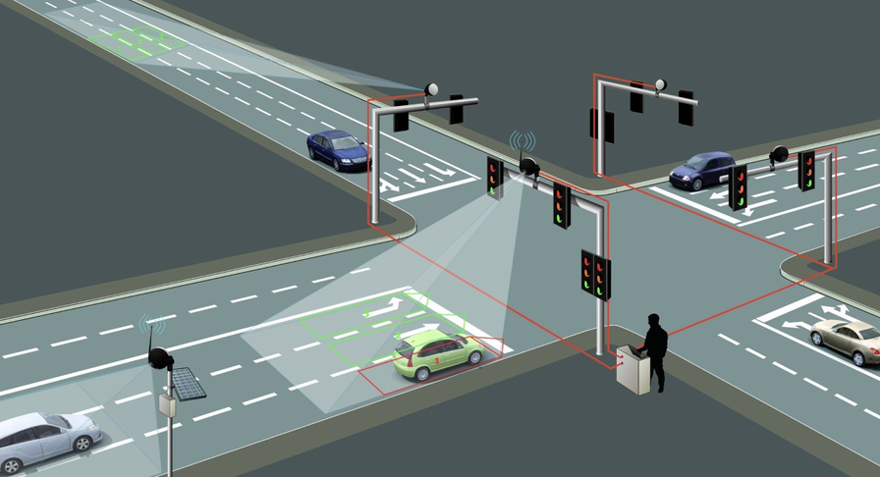
WHY IS IT NEEDED?
A traffic light controller is needed to regulate traffic flow, prevent collisions, and improve overall road safety.
Without proper traffic light control, intersections could become chaotic, leading to accidents and congestion.

Slide 5
APPLICATION
TRAFFIC FLOW CONTROL
They help control traffic at intersections, telling cars and pedestrians when to go and when to stop.
INTERSECTION SAFETY
They make intersections safer by managing the timing of traffic lights, reducing the chances of accidents.
PEDESTRIAN SAFETY
They ensure safe crossing for pedestrians by controlling when they can walk across the street.
REDUCING CONGESTION
By managing traffic efficiently, they help minimize wait times and reduce traffic jams.
ADAPTING TO CHANGES
Smart controllers can adjust to changing traffic conditions, making the transportation system more flexible.

Slide 6
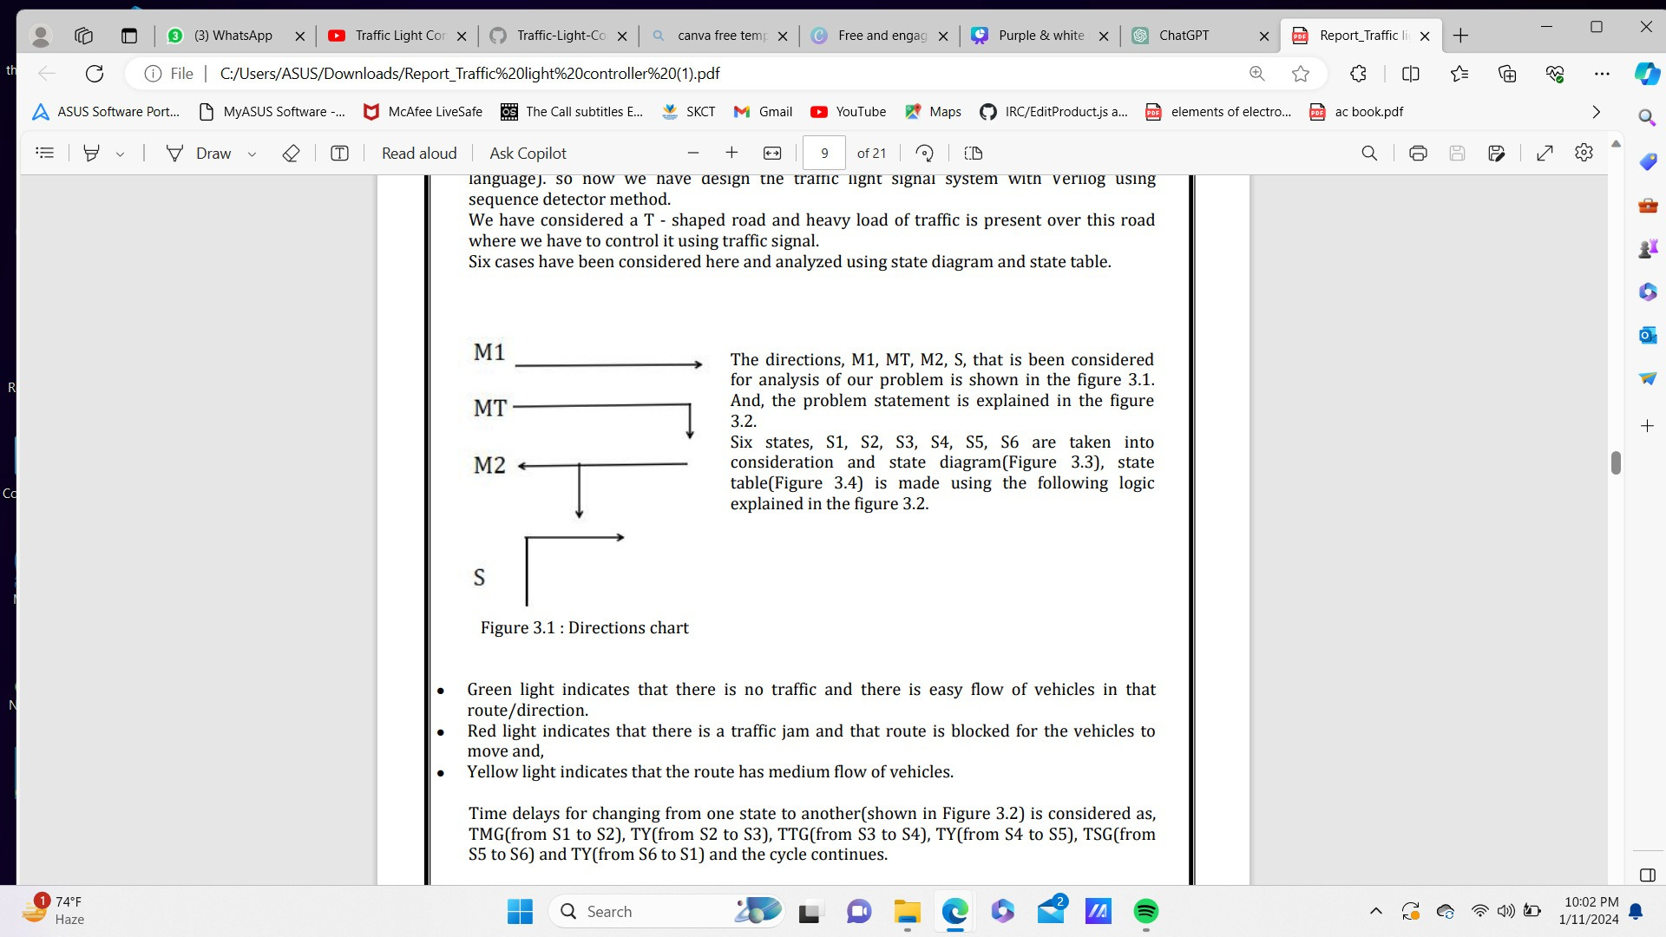
DESIGN METHODOLOGY
Verilog is a hardware descriptive language (HDL) which is generally used to model electronic system.we have design the traffic light signal system with Verilog using sequence detector method.
We have considered a T - shaped road and heavy load of traffic is present over this road where we have to control it using traffic signal
The directions M1, MT, M2, S, that is been considered for analysis of our problem

Slide 7
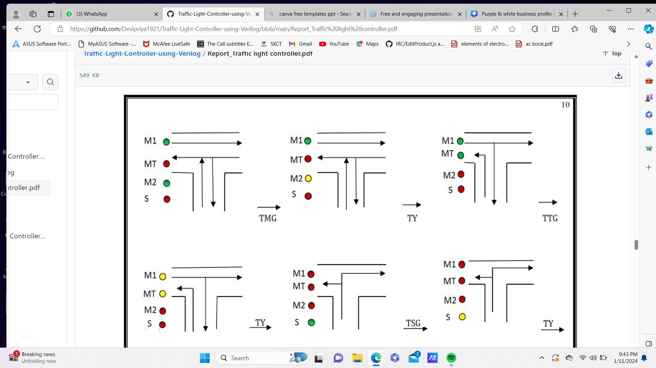
DESIGN METHODOLOGY (CONTIN..)
TIME DELAY’S
TMG - 7 seconds
TY - 2 seconds
TTG - 5 seconds
TSG - 3 seconds

Slide 8
Green light indicates that there is no traffic and there is easy flow of vehicles in that route/direction.
Red light indicates that there is a traffic jam and that route is blocked for the vehicles to move and, Yellow light indicates that the route has medium flow of vehicle.

Slide 9
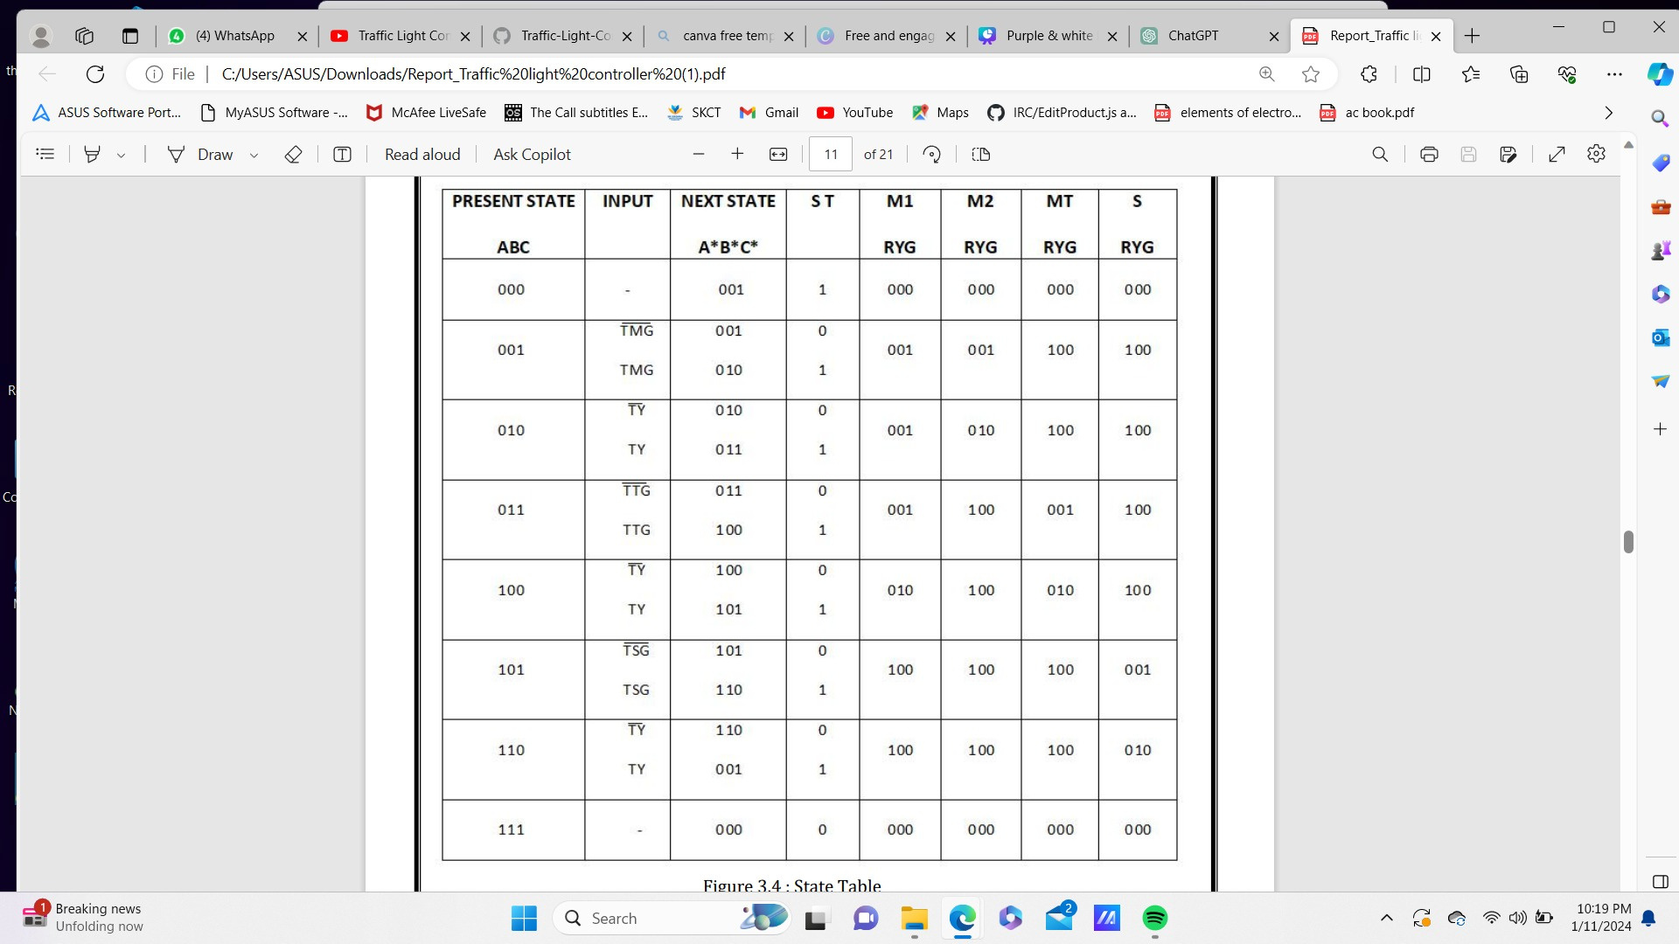
STATE TABLE

Slide 10
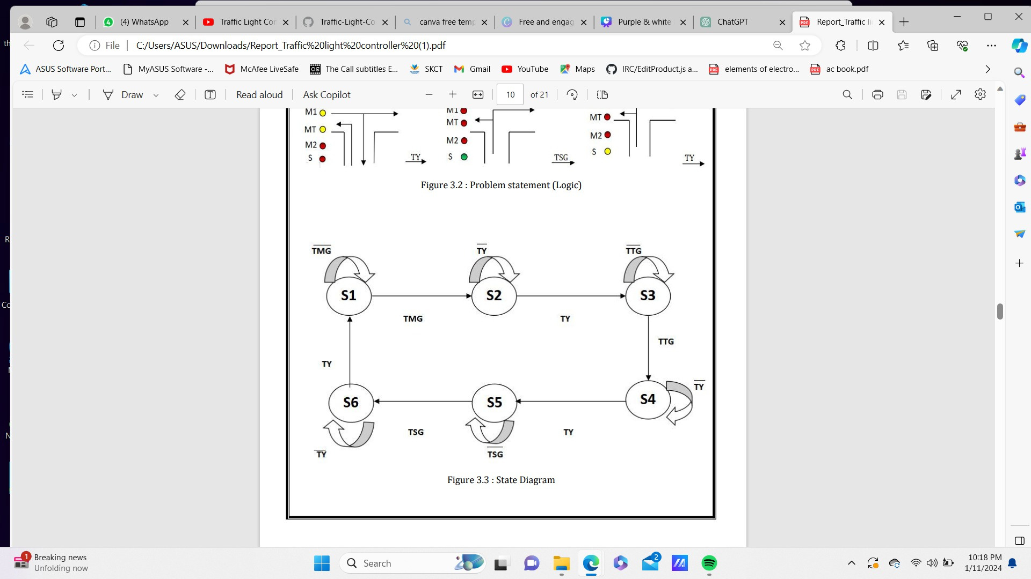
STATE DIAGRAM

Slide 11

Result Implementation

Slide 12
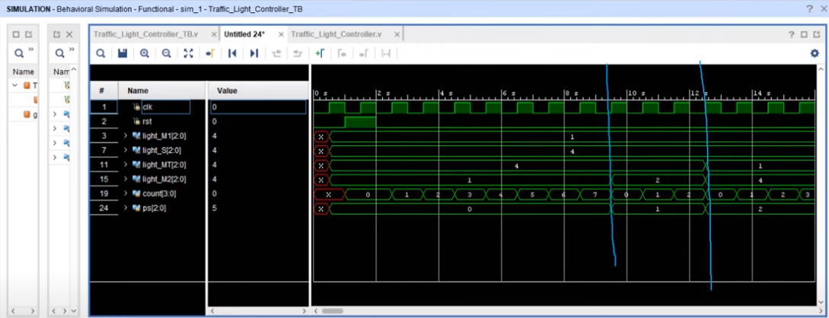
Result 1

Slide 13
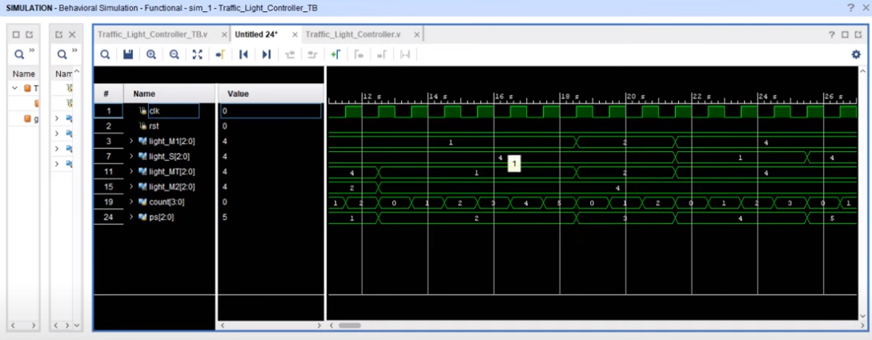
Result 2

Slide 14
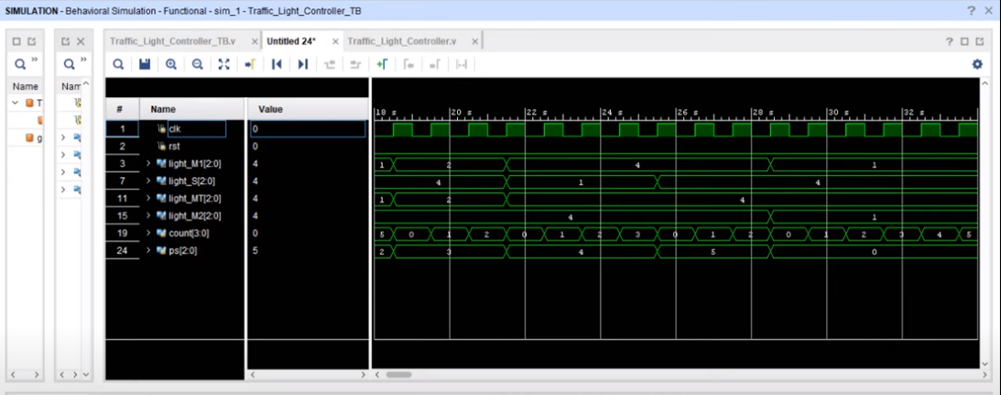
Result 3

Slide 15
THANK YOU

